Slide 1
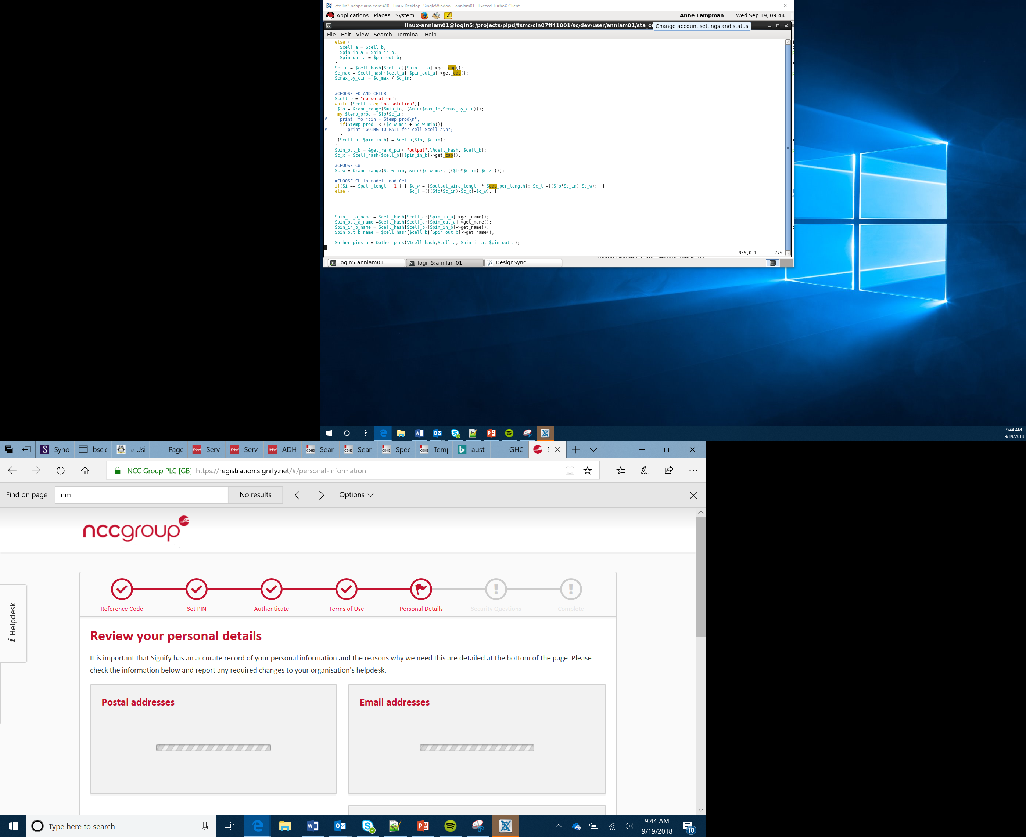

Smart Car
Marketing
Lesson 21

Slide 2
Objectives
Identify the major selling features of your vehicle
Create and present a promotional advert (eg PowerPoint, video) aimed at your stakeholders
Create and present a promotional advert (eg brochure, TV advert, Poster) aimed at your consumers
Notes:
Introduce the objectives

Slide 3
Review
We have decided on the logo and branding for our vehicle
We have performed a SWOT analysis and identified our market and stakeholders
In the last few lessons you have designed the prototype for your car.
Now its time to SELL, SELL, SELL
Notes:
Look back at what Learners have created and explain that Learners now need to market and sell it

Slide 4
Audience and Purpose
When presenting information, consider:
Audience
Purpose
Present the information clearly so it can be easily understood
The publication you create will need to serve your purpose so ensure:
You know the purpose is
You match the needs and interests of the audience – what do they want to know?
Watch the video on the next slide with some example car adverts – these adverts are targeting the consumer. How can you tell?
Content
Layout
Notes:
Discuss with Learners the context of Target audience and Purpose
Explain how this will change depending who Learners are presenting to and what they are trying to achieve
Show the YouTube video https://www.youtube.com/watch?v=tuXJwR7SKok or equivalent video of tv adverts for cars. Look at how the use of sound and visuals to promote the brand.

Slide 5

Car Adverts
Notes:
Large online version of the video below
New Skoda Fabia Advert - Full of lovely stuff

Slide 6
Considerations
How are you going to market your vehicle?
What type of marketing media best suits your audience or will enable global mass market penetration
Web
TV
Radio
Social media
Billboards
Brochures
Celebrity endorsements
Notes:
Discuss how Learners can market their vehicle and what mediums would be best to present it in.
Talk about the upcoming task and the different audiences and purposes
Get Learners thinking about the features their vehicle has and how this will be important to either stakeholder, consumer or both
Look at the different media types

Slide 7
Considerations
How will you value your company and product?
Value Proposition – A clear statement that explains how your product solves the customers problems or improves their situation
What benefits will it bring (measurable – will it save them money? How much?)
Why should they buy your product and not your competitions?
What is unique about you?
Notes:
Explain that Learners have to show that the product has value - not just monetary but what benefits will it bring.
This could be environmental, accessibility etc

Slide 8
Marketing
Design and create at least two of the following:
A presentation that you will give to stakeholders that explains the benefits of your new self-driving car and encourage them to mass produce your prototype
A brochure that can be handed out in dealerships to consumers
A radio or tv advert to promote your vehicle aimed at the consumer
A social media campaign about your vehicle
Notes:
Explain the task to the Learners
Explain to Learners what software the school has available for
Presentation (eg PowerPoint)
Printed Adverts (eg Publisher or Writer)
Radio Adverts (eg Audacity is free)
Video/TV Advert (Windows movie maker or equivalent)

Slide 9
Success Criteria
Identify the major selling features of your vehicle
Create and present a promotional advert (e.g. PowerPoint, video) aimed at your stakeholders
Create and present a promotional advert (e.g. brochure, TV advert, Poster) aimed at your consumers
Stretch Task – design a social media campaign to launch your vehicle
Notes:
Work through the lesson activity sheet and encourage Learners to complete the Stretch Tasks

